Slide 1
Agenda 11/4/2016
Finish up slides from last time
Questions about BoolOps project
zyBooks: 12.1-12.3, more later!
Recursion worksheet
Recursion: good/bad/ugly
The golden ratio

Slide 2


Recursion Part 2
Lecture 12: Recursion worksheet
Lecture 13: finish “The good, the bad, and the ugly”
"Il Buono, il brutto, il cattivo"

Slide 3
The Good
Good recursion:
Elegant, easily understood
fairly efficient
Tower of Hanoi
Maze traversal

Slide 4
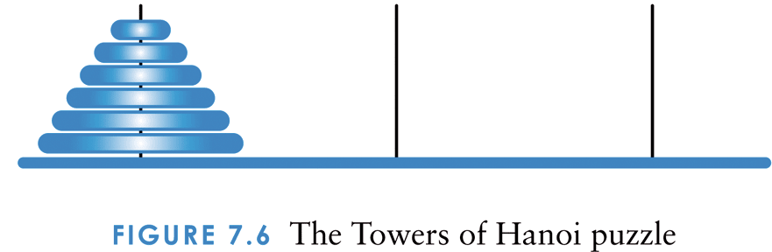
The Towers of Hanoi
The goal is to move all of the disks from one peg to another following these rules:
Only one disk can be moved at a time
A disk cannot be placed on top of a smaller disk
All disks must be on some peg (except for the one in transit)

Slide 5
Recursive Towers of Hanoi
Source=A, spare= B, destination= C: hanoi (int n, char src, char dst, char spr)
Base case: stack contains 1 disk. Move from peg A to C.

Slide 6
Source=A, spare= B, destination= C: hanoi (int n, char src, char dst, char spr)
Inductive case:
move topmost n-1 disks from A to B, using C for temporary storage.
Move bottom disk from A to C (B temp)
Move n-1 disks from B to C (A temp).

Slide 7
// Towers of Hanoi
void Hanoi(int n, char src, char dst, char spr)
{
if (n == 1) { // anchor (base) case
System.out.println("Move disk from " + src + “ to “ + dst);
Return; }
// (else) inductive case
Hanoi(n-1, src, spr, dst); // un-stack topmost
Hanoi(1, src, dst, spr); // move bottom (largest)
Move(n-1, spr, dst, src); // re-stack the rest
}

Slide 8
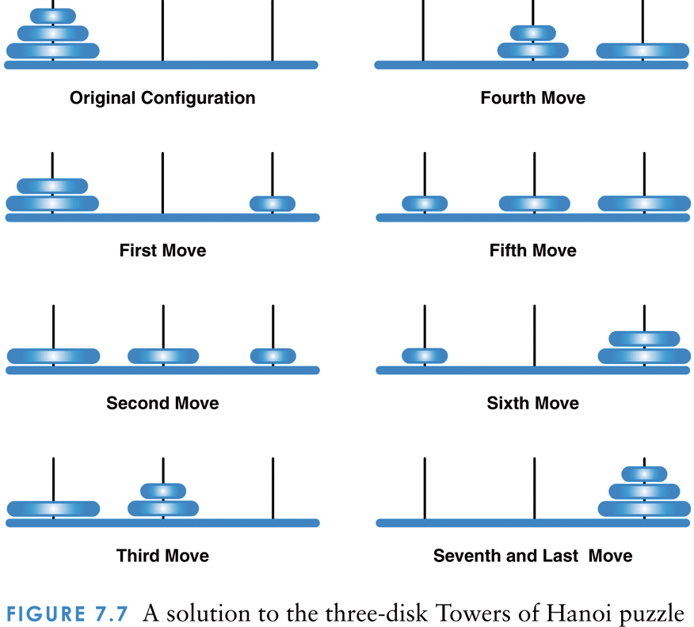
A solution to the three-disk Towers of Hanoi puzzle
move 1 disk from A to C
move 1 disk from A to B
move 1 disk from C to B
move 1 disk from A to C
move 1 disk from B to A
move 1 disk from B to C
move 1 disk from A to C
How many moves are required for N disks?

Slide 9
Towers of Hanoi
Note that the number of moves increases exponentially as the number of disks increases :
-1 Where n is the number of disks
The recursive solution is simple and elegant to express (and program)
An iterative solution to this problem is much more complex
2^{n}

Slide 10
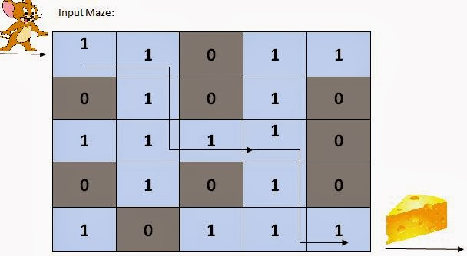
Good: Maze Traversal
Recursion will be used to keep track of the path through a maze (represented by a 2D array) using the run-time stack.
The stack keeps track of the visited paths, and allows us to “backtrack” to new paths

Slide 11
Good: Maze Traversal
The base cases are
a prohibited (blocked) move, or
arrival at the final destination
Recursive cases: check path in U/D/L/R direction
Requires coverage of 2D arrays – next!

Slide 12
The Bad
Bad recursion: In computer science, tail recursion (or tail-end recursion) is a special case of recursion in which the last operation of the function is a recursive call. Such recursions can be easily transformed to iterations. Replacing recursion with iteration, either manually or automatically, can drastically decrease the amount of stack space used and improve efficiency. (wikipedia)
Factorial, sum, numDigits

Slide 13
Bad: Recursive power(x, n)
// recursive version of power:
// computes x to the nth power
long power(int x, int n)
{
if (n ==0) return 1;
else
return x * power(x, n-1);
}

Slide 14
Iterative version of power(x, n)
// iterative version of power:
// computes x to the nth power
// x to the nth power = (x*x...) n times
long power(int x, int n)
{
long answer =1;
if (n ==0) return answer;
while (n-- > 0) answer = answer*x;
return answer;
}

Slide 15
// Counting the number of digits in a positive integer
int F(unsigned n, int count) { // recursive, expensive! if (n < 10) return 1 + count;
else
return F(n/10, ++count);
}
int F(unsigned n)
{ // iterative, cheaper
int count = 0;
while ( n >= 10)
{
count++;
n /= 10;
}
return count;
}
More complicated recursive functions are sometimes replaced by iterative functions that use a stack to store the “recursive” calls.

Slide 16

Fibonacci 1170- about 1250

Slide 17
The Ugly
Lots of wasted and duplicated effort.
Fibonacci sequence:
Base: Fib(1) = 1; Fib(2) = 1;
Recursive: Fib(n) = Fib(n-1) + Fib(n-2);
Sequence: 1,1,2,3,5,?, ?

Slide 20
Fibonacci Trace

Slide 21
Fibonacci without recursion
Without Recursion int fibo(int n){ if(n <= 2){ return 1; } int fibo = 1; int fiboPrev = 1; for(int i = 2; i < n; ++i){ int temp = fibo; fibo = fibo + fiboPrev; fiboPrev = temp; } return fibo; }

Slide 22

The Golden Ratio (or "Golden Section") is based on Fibonacci Numbers, where every number in the sequence (after the second) is the sum of the previous 2 numbers:
1, 1, 2, 3, 5, 8, 13, 21, ...
We will see how the Fibonnaci Numbers lead to the Golden Ratio:
Φ = 1.618 033 ...
Much of this info from: www.intmath.com

Slide 23
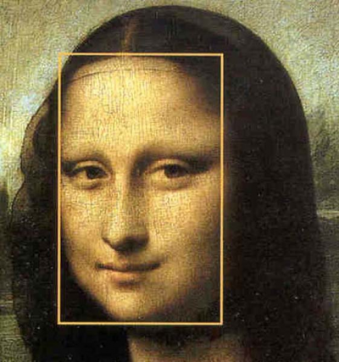
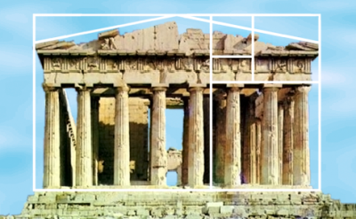

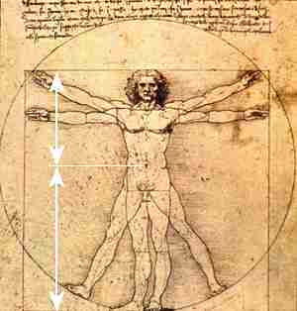
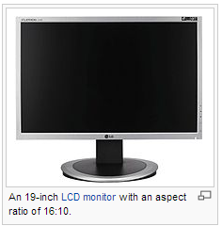
1: 1.618

Slide 24
Let's look at the ratio of each number in the Fibonacci sequence to the one before it:
1/1 = 1
2/1 = 2
3/2 = 1.5
5/3 = 1.666...
8/5 = 1.6
13/8 = 1.625
21/13 = 1.61538...
34/21 = 1.61905...
55/34 = 1.61764...
89/55 = 1.61861...
If we keep going, we produce an interesting number which mathematicians call "phi" (Golden Ratio or Golden Section):
Φ = 1.618 033 988 7...

Slide 25
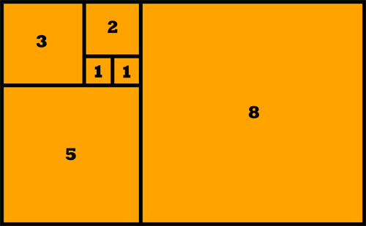
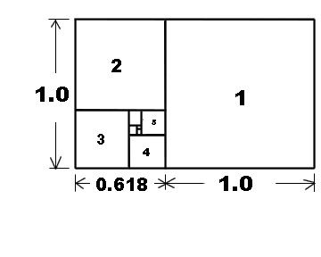
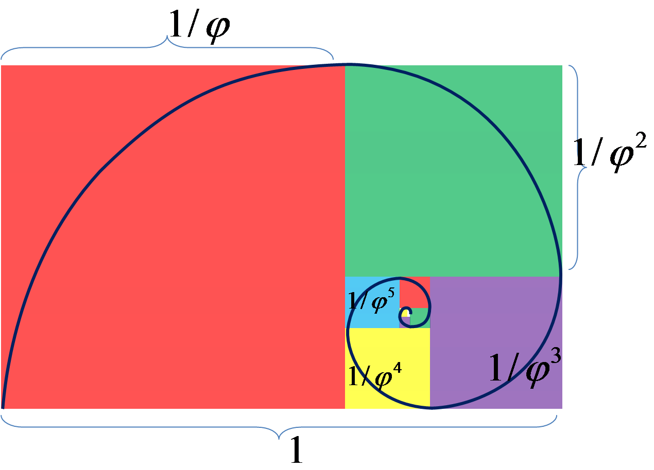
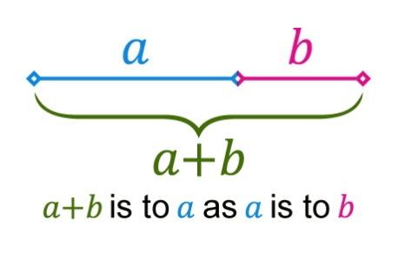
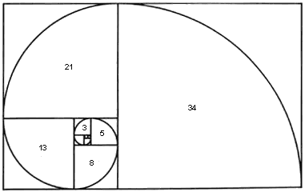
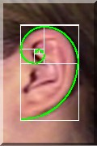


Slide 26
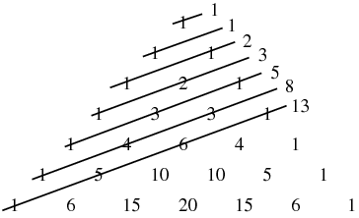
Fibonacci and Pascal’s triangle

Slide 27
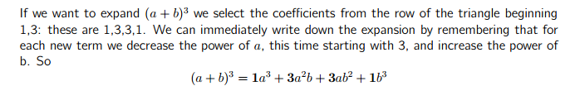
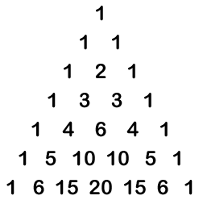
Fibonacci and the Binomial theorem

Slide 28
Definition
Direct Recursion
When a method invokes itself
Indirect Recursion
Method A calls Method B which calls Method A
Can be many levels deep
Difficult to understand and trace
Happens naturally in certain situations

Slide 29
Also Ugly: Indirect Recursion
A method invoking itself is considered to be direct recursion
A method could invoke another method, which invokes another, etc., until eventually the original method is invoked again
For example, method m1 could invoke m2, which invokes m3, which invokes m1 again
This is called indirect recursion
It is often more difficult to trace and debug

Slide 30
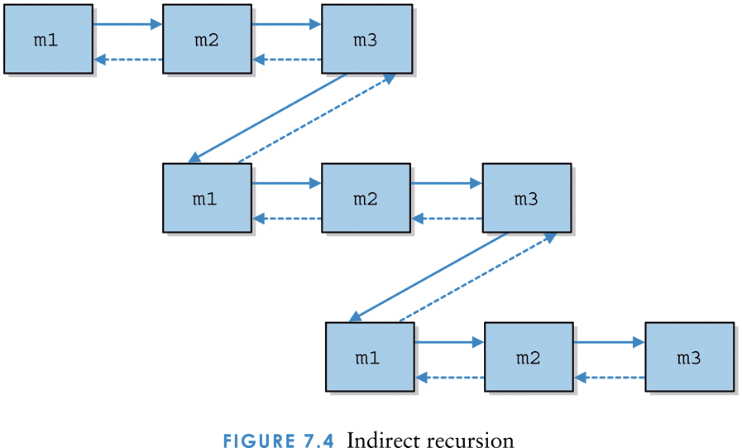
Indirect recursion

